Slide 1
Business Intelligence in Practice Make a data chart
Dr. Kate Han

Slide 2
Why data matters in BI?
Align your business to appropriate BI and analytical solutions.
By using a data understanding framework, you will know your data inventory
Understand data sources and uses and be better positioned for success.
Support decision making in business
Convert business to data-driven

Slide 3
How to use data matters for BI?
Prioritize BI/analytics efforts to meet business needs.
Reach consensus on business vocabulary and definitions.
Craft solutions that meet all customer needs and deliver value.
Manage costs and risks embedded in current reporting and BI approaches.
Partner to expedite “time-to-market” (learn and share).

Slide 4
Understand your data
What is Data?
Make your own Graphs
Data is a collection of facts, such as numbers, words, measurements, observations or just descriptions of things.
Discrete Data vs Continuous Data
Discrete Data can only take certain values.
Continuous Data can take any value (within a range)
Explore the wonderful world of graphs.
Create your own, and see what different functions produce.
Get to understand what is really happening.

Slide 5
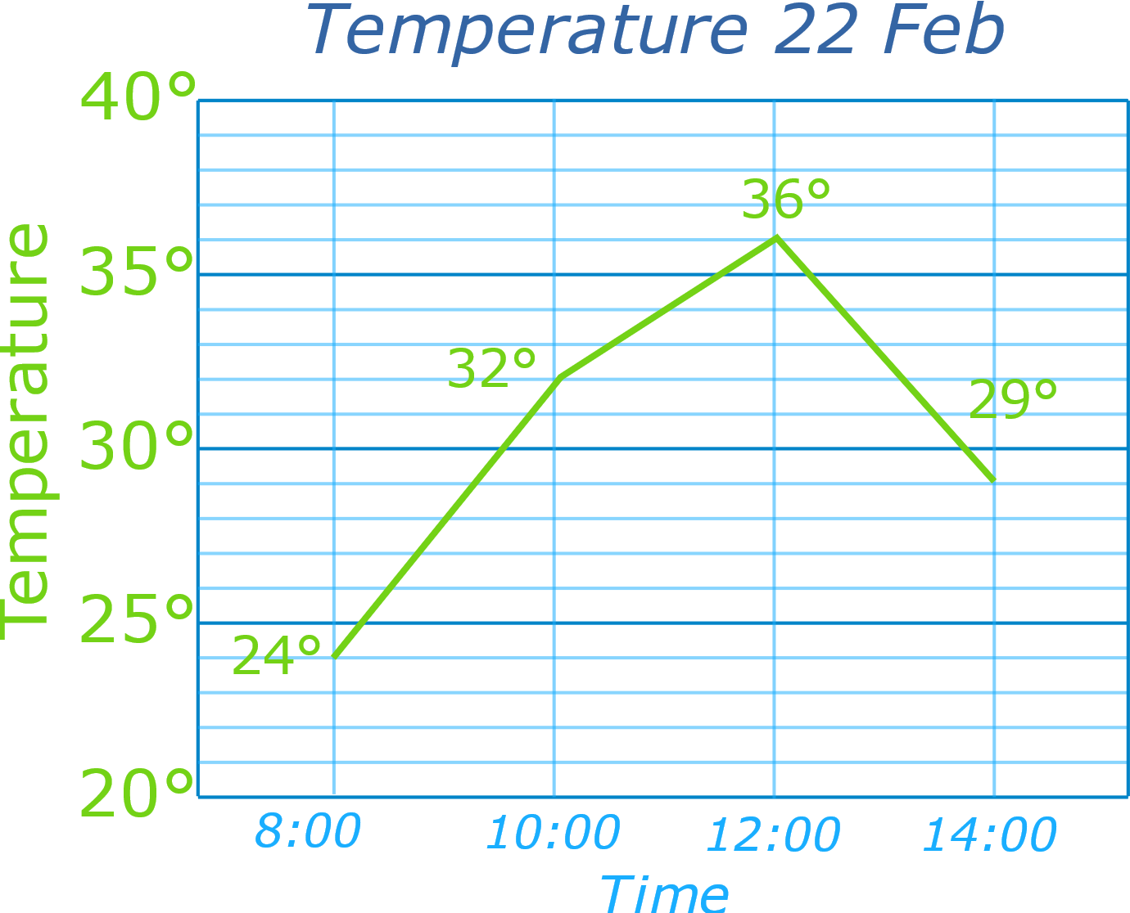
Line Graph: a graph that shows information connected in some way (usually as it changes over time).
You record the temperature outside your house and get these results:
You are interested to see how it rises and falls, so decide to make a line graph:
Table: Temperature 22 Feb
8:00 | 10:00 | 12:00 | 14:00
24° | 32° | 36° | 29°

Slide 6
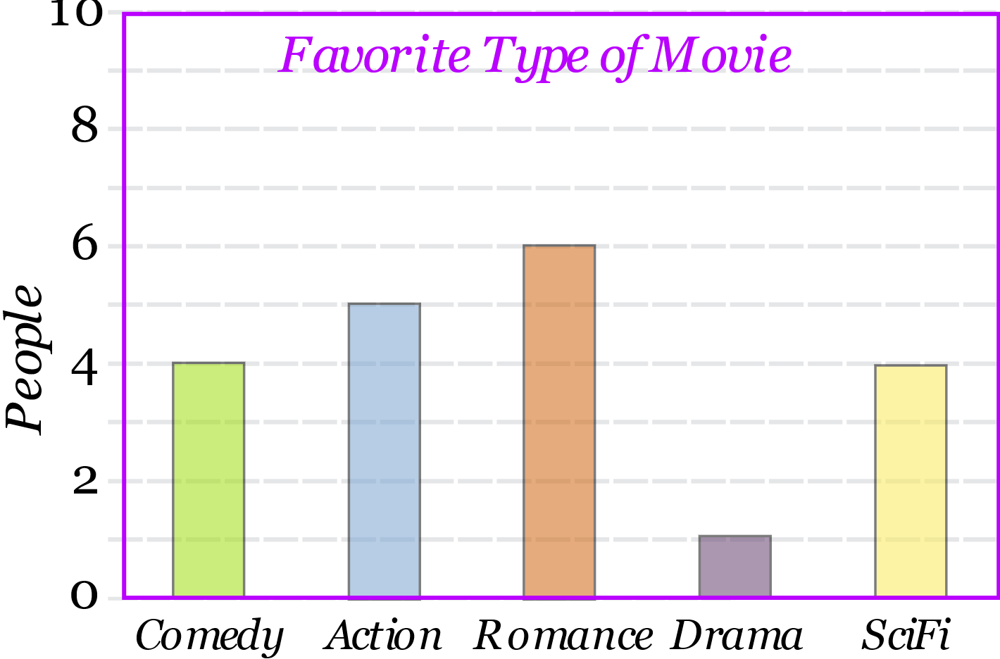
A Bar Graph (also called Bar Chart) is a graphical display of data using bars of different heights.
Imagine you just did a survey of your friends to find which kind of movie they liked best:
We can show that on a bar graph like this:
Table: Favourite Type of Movie
Comedy | Action | Romance | Drama | SciFi
4 | 5 | 6 | 1 | 4

Slide 7
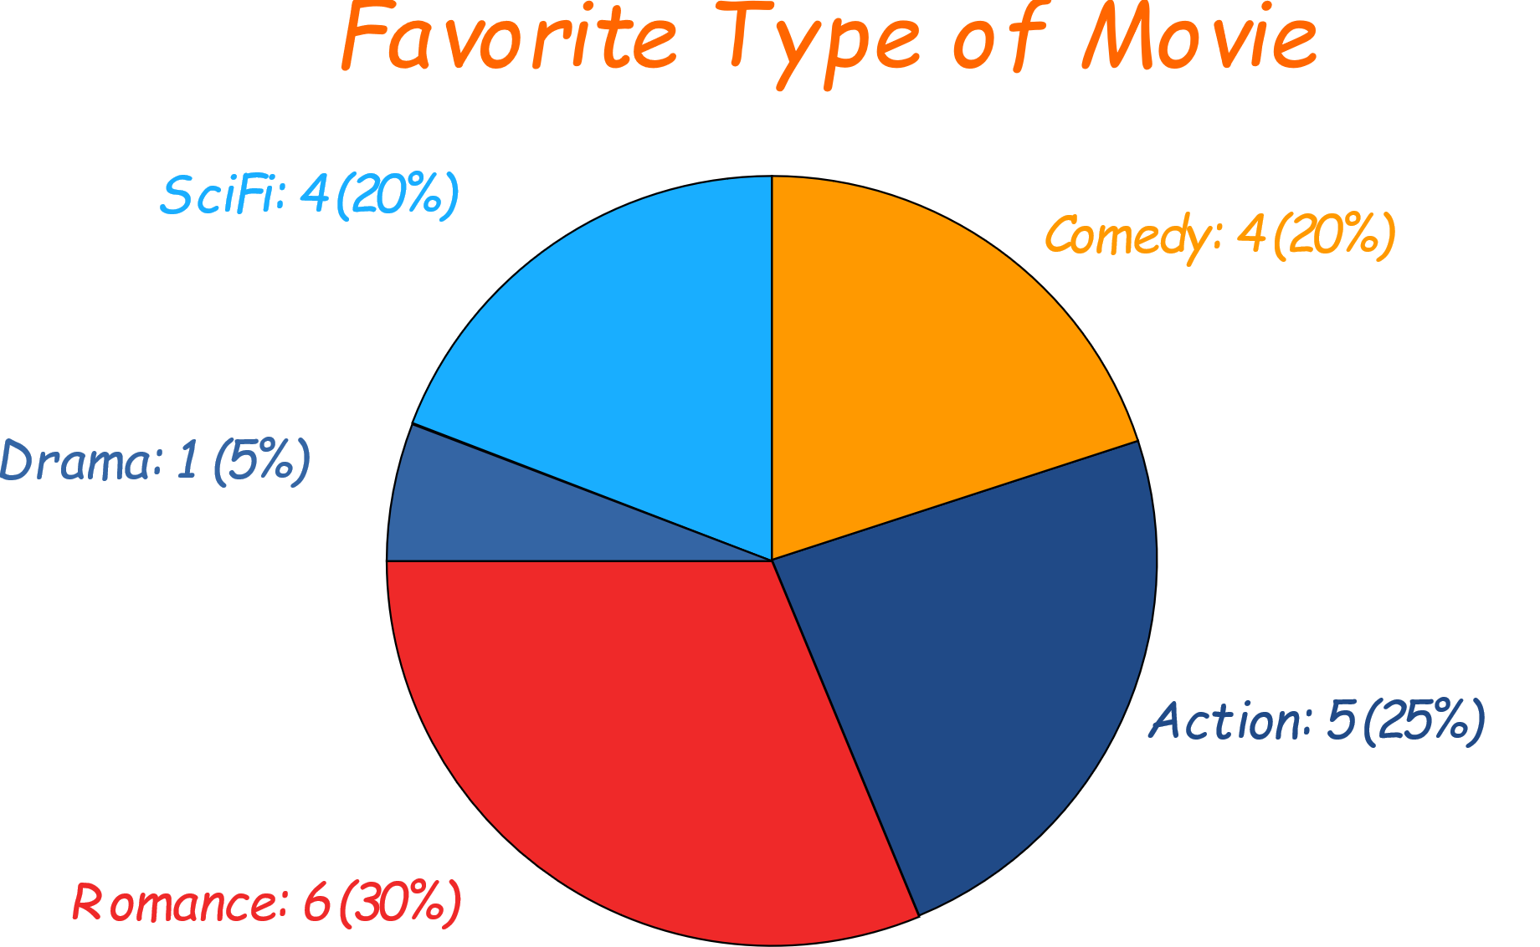
Pie Chart: a special chart that uses "pie slices" to show relative sizes of data.
Imagine you survey your friends to find the kind of movie they like best:
You can show the data by this Pie Chart:
Table: Favourite Type of Movie
Comedy | Action | Romance | Drama | SciFi
4 | 5 | 6 | 1 | 4

Slide 8
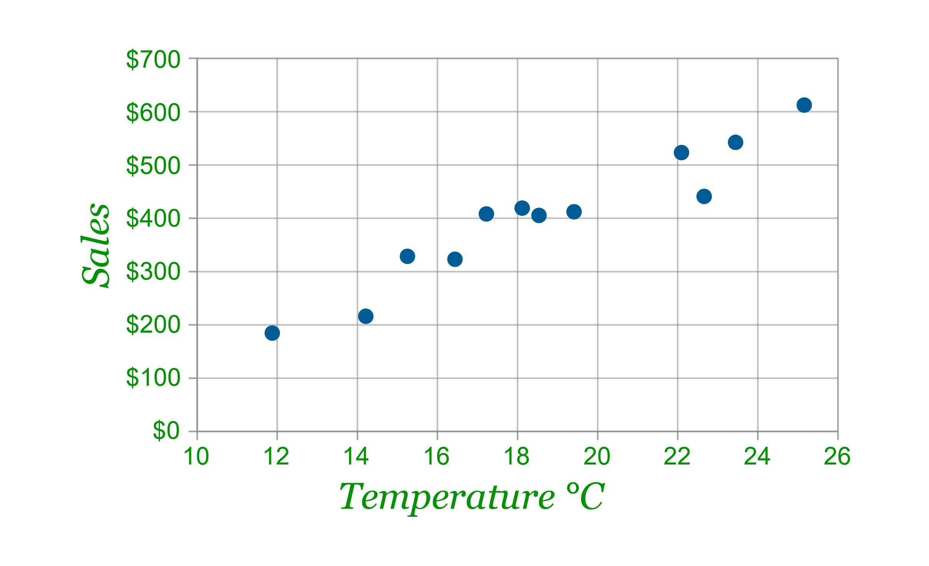
A Scatter (XY) Plot has points that show the relationship between two sets of data.
The local ice cream shop keeps track of how much ice cream they sell versus the noon temperature on that day. Here are their figures for the last 12 days:
And here is the same data as a Scatter Plot:
Ice Cream Sales vs Temperature
Temperature °C | Ice Cream Sales
14.2° | $215
16.4° | $325
11.9° | $185
15.2° | $332
18.5° | $406
22.1° | $522
19.4° | $412
25.1° | $614
23.4° | $544
18.1° | $421
22.6° | $445
17.2° | $408

Slide 9
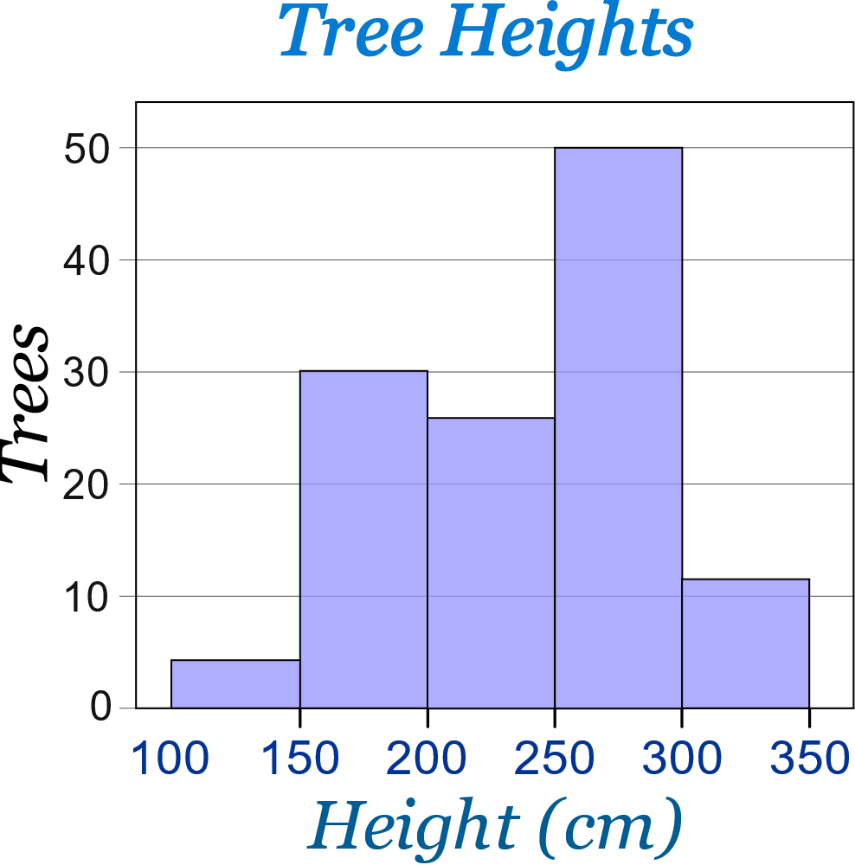

Histogram: a graphical display of data using bars of different heights.
Example: Height of Orange Trees
And here is the result:
You can see (for example) that there are 30 trees from 150 cm to just below 200 cm tall
You measure the height of every tree in the orchard in centimetres (cm)
The heights vary from 100 cm to 340 cm
You decide to put the results into groups of 50 cm:
The 100 to just below 150 cm range,
The 150 to just below 200 cm range,
etc...
So a tree that is 260 cm tall is added to the "250-300" range.

Slide 10
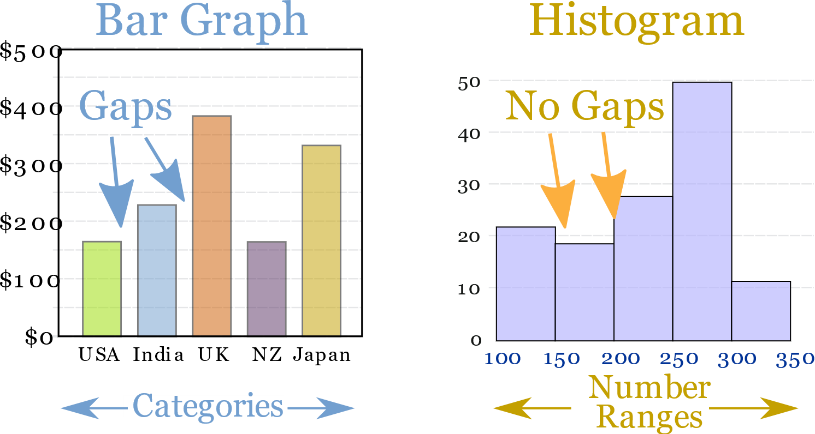
Bar vs Histogram
Histograms are a great way to show results of continuous data, such as:
But when the data is in categories we should use a Bar Chart.
weight
height
how much time
etc.
Country
Favourite Movie
etc.

Slide 11
Thank you!

